Slide 1
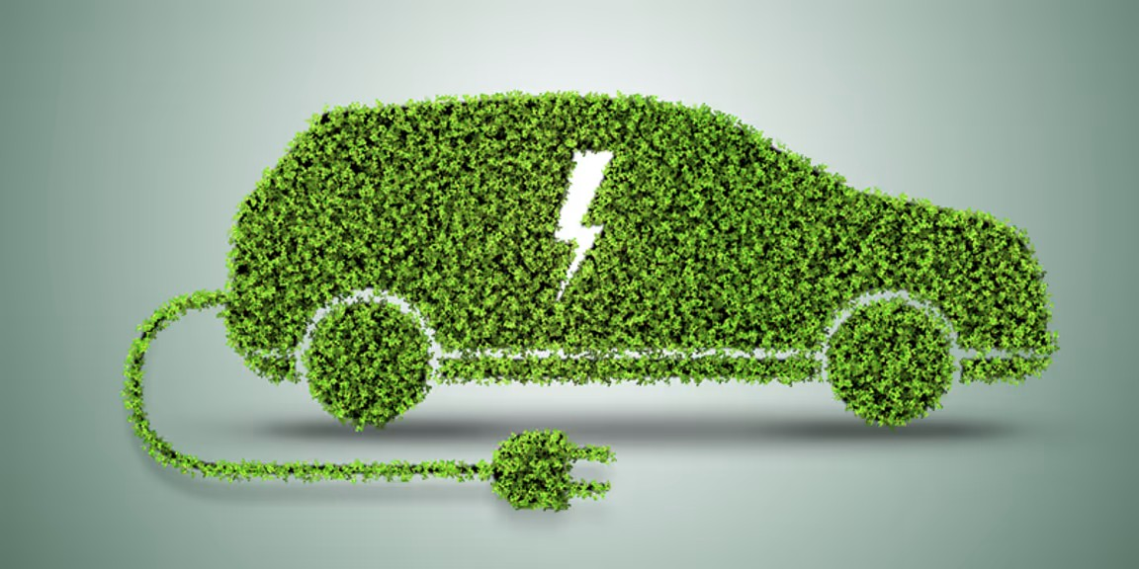
ELECTRIC VEHICLE POPULATION DATA ANALYSIS
Created by – Syed Afaq Ahmed

Slide 2
DATASET OVERVIEW
The dataset provided detailed information about electric vehicles, including their VIN, model, model year, manufacturer, electric vehicle type, CAFV eligibility, electric range, and base MSRP.
The dataset also included information about the state, country, and city to which each vehicle belonged.

Slide 3
TOOLS USED
Tableau Public

Slide 4
STEPS FOLLOWED
Looked for anomalies in data, analysed the data
Postal code, Legislative district, DOL vehicle ID, vehicle location, electric utility and 2022 census tract
columns were not required for analysis
Calculated total vehicles, average electric range, total BEV & total PHEV
Created slicers(filters) and visualisation using charts appropriate for the data
These charts and filters were organised and formatted
The year 2024 was excluded as an outlier using filters because it only contained data for January.

Slide 5
FINDINGS

Slide 6
Total Vehicle = 1,30,520
Battery Electric Vehicle (BEV) = 1,04,755 – constitutes 80.3% out of total vehicles
Plugin Hybrid Electric Vehicle (PHEV) = 25,765 – constitutes 19.7% out of total vehicles

Slide 7


What is the average electric range of plug-in hybrid electric vehicles (PHEVs) and battery electric vehicles (BEVs)?
We can conclude that BEV sales are higher compared to PHEV sales, as BEVs typically offer a greater average electric range than PHEVs.
BEV
PHEV

Slide 8
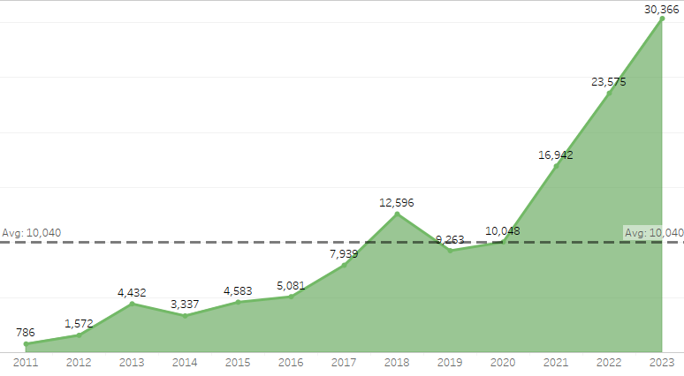
What are the trends in electric vehicle (EV) adoption
The usage of electric vehicles has steadily increased over the years, although there was a slight decline between 2019 and 2020.
Increased environmental awareness, concern, and advancements in technology have gradually boosted the usage of electric vehicles at the end of 2020

Slide 9
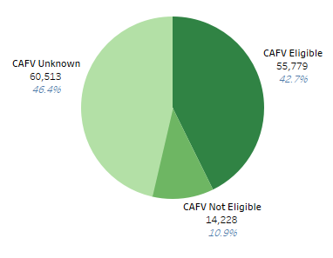
What portion of total vehicles are CAFV eligible?
The largest share is vehicles with unknown eligibility, followed by those that are eligible, and the smallest portion represents non-eligible vehicles.

Slide 10
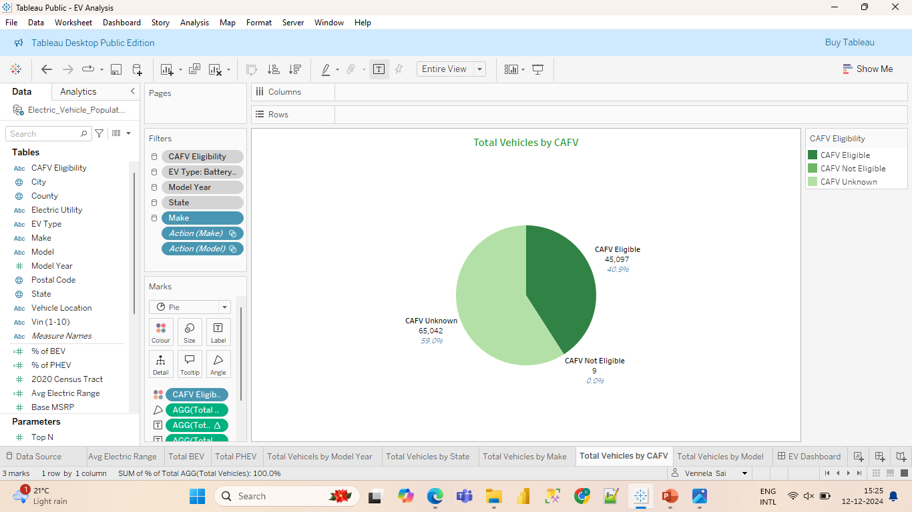
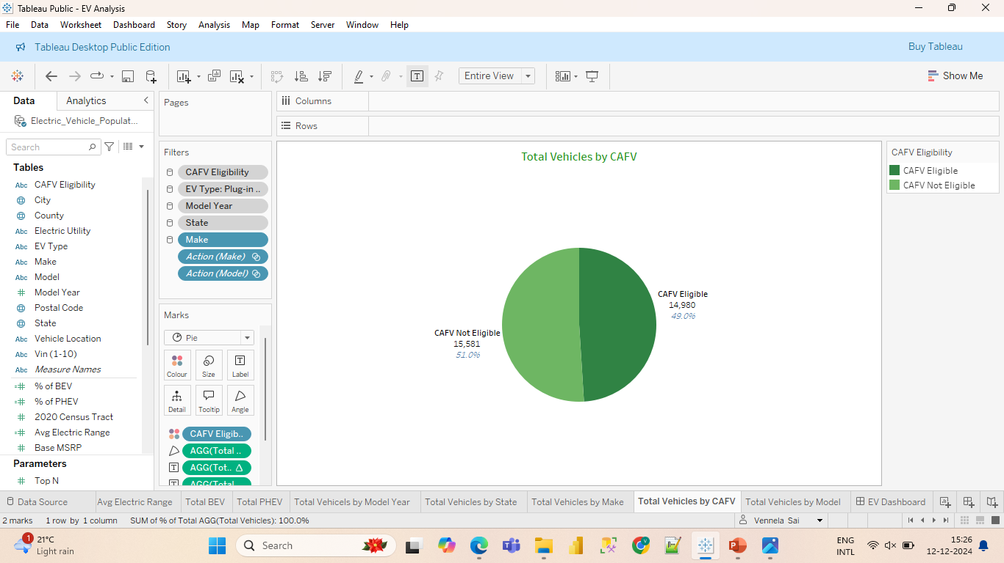
What portion of total vehicles are CAFV eligible, categorised by type?
BEV: The majority of vehicles have "Unknown" eligibility, which are under R&D. A significant portion qualifies for CAFV programs, while very few vehicles fall under the "Not Eligible" category.
The pie chart shows two nearly equal categories, with "CAFV Not Eligible" slightly larger than "CAFV Eligible," indicating a minor imbalance.
BEV
PHEV

Slide 11
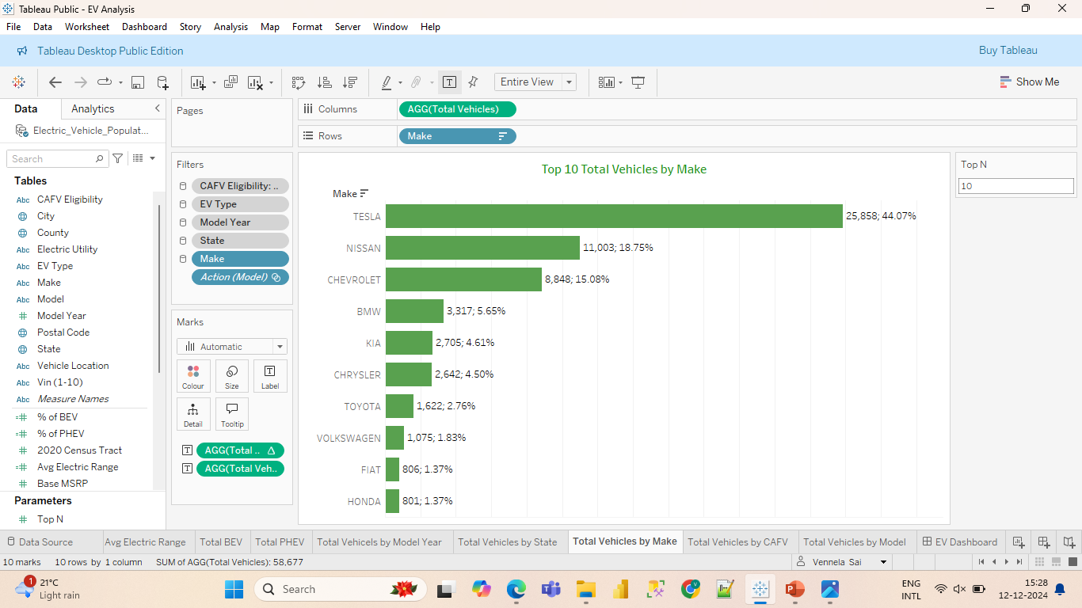
What is the CAFV eligibility of vehicles based on their make?
A significant percentage of Tesla vehicles have demonstrated CAFV eligibility compared to other manufacturers.
Manufacturers other than Tesla have more vehicles that are not CAFV eligible than those that are eligible.
Tesla has more vehicles with unknown CAFV eligibility, which are under R&D compared to other manufacturers.
CAFV eligible

Slide 12
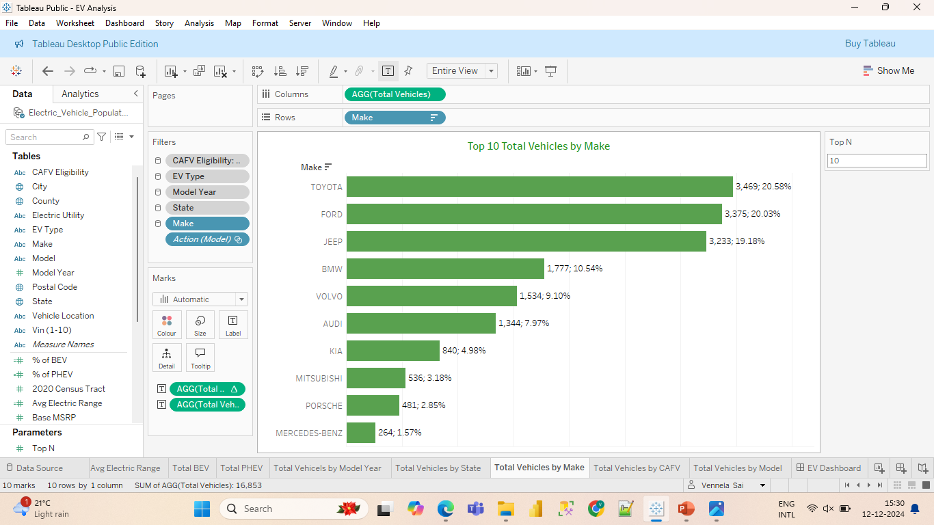
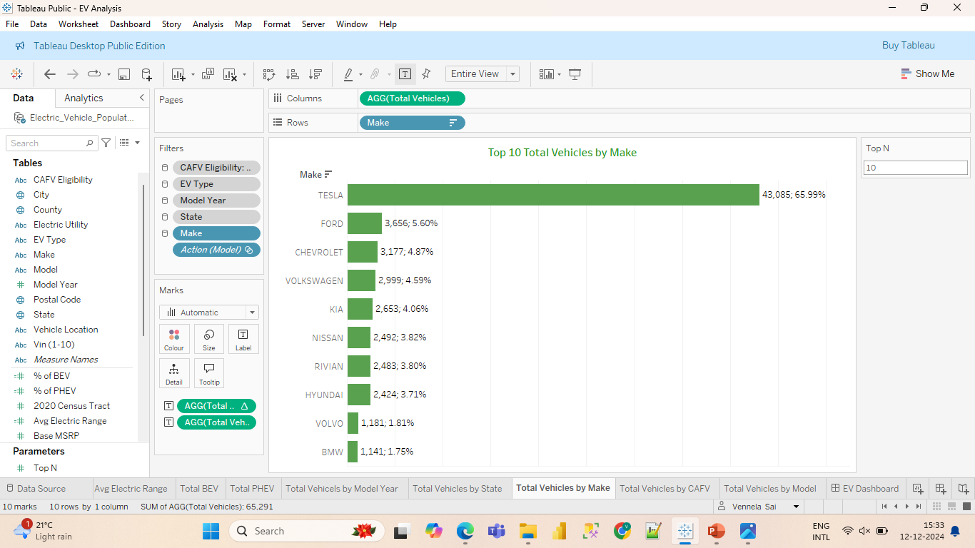
CAFV not eligible
CAFV unknown

Slide 13
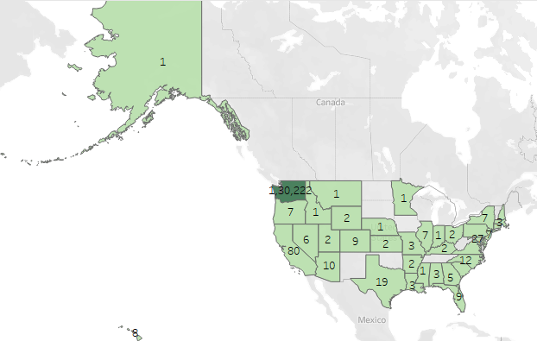
Which state has the highest number of electric vehicle users?
Washington has the highest number of electric vehicle users, followed by California

Slide 14
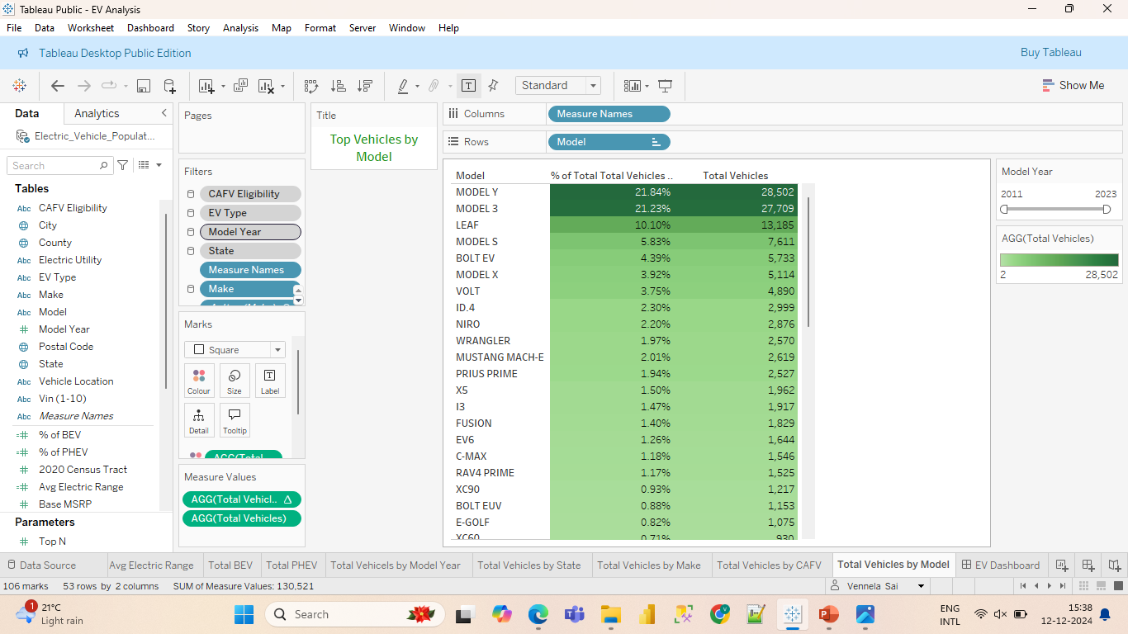
Which are the top models used?
The majority of people use the MODEL Y (by Tesla), followed by the MODEL 3 (by Tesla) and the LEAF (by Nissan).

Slide 15
RECOMMENDATIONS

Slide 16
Since BEVs have a higher average electric range compared to PHEVs, manufacturers should focus on producing more BEVs or improving the electric range of PHEVs.
Manufacturers can confidently increase production with upgradations, as the growing shift toward eco-friendly initiatives is driving an upward trend in buyers.
Manufacturers other than Tesla should focus on improving their vehicles to meet CAFV eligibility standards.
Nissan should work on improving the efficiency or design of the LEAF model, as it has significant growth potential.
Manufacturers should launch marketing campaigns in California due to its high growth potential.
Electric vehicles (EVs) benefit the environment by reducing emissions, improving air quality, and supporting renewable energy use. They are energy-efficient, quiet, and promote sustainable innovations, making them crucial for combating climate change.

Slide 17
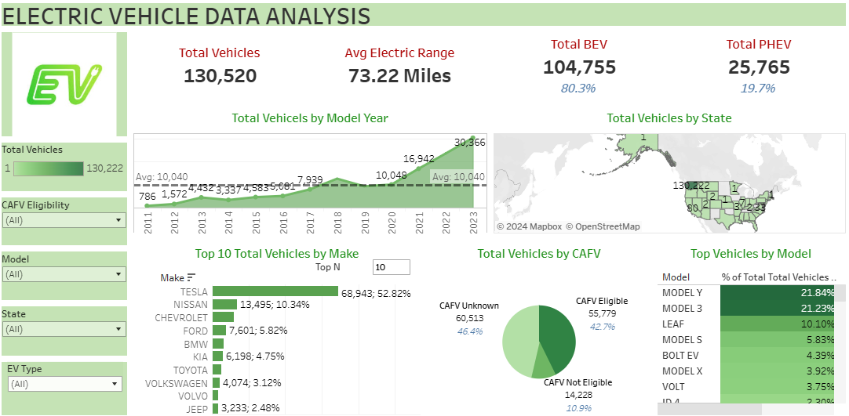

Slide 18
THANK YOU

